Slide 1
Modes of Transfer
(Lecture 46-48)

Slide 2
Data Transfer
Introduction:-
Binary information received from an external device typically resides in memory for subsequent processing. When information is transmitted from the central computer to an external device, it originates from the memory unit. While the CPU executes instructions, such as I/O, it may temporarily hold the data, but the primary source or destination remains the memory unit.
Data transfer between the central computer and I/O devices can occur through various modes, with some utilizing the i) CPU as an intermediary and ii) others directly accessing the memory unit. Transfer of data to and from peripherals can be managed in one of following possible modes.
1. Programmed I/O 2. Interrupt-initiated I/O
3.Direct memory access (DMA)
4. Dedicated processor, such as input–output processor (IOP)
5. Dedicated processor like DCP

Slide 3
Data Transfer Modes
3 main modes of data transfer between computer (memory) and I/O devices:-
Programmed I/O
Interrupt-Initiated I/O
Direct Memory Access (DMA)
CPU controls the transfer
CPU executes several instructions
Continuous monitoring of flag bit
Slow and inefficient
CPU is involved in the transfer
No continuous monitoring of flag bit
Interface interrupts the CPU
CPU is not involved in the transfer of data between memory and I/O
DMA controller takes control of the memory bus
Ideal for fast memories

Slide 4
Data Transfer Modes – Cont..
Other modes of data transfer between computer (memory) and I/O devices:-
Input–output processor (IOP)
Data Communication Processor (DCP)
IOP is a special dedicated processor that combines interface unit and DMA as one unit.
It can handle many peripherals through DMA and interrupt facility.
slow and wastes maximum of processor’s time.
DCP is also a special-purpose dedicated processor that is designed specially for data transfer in network.
DCP communicates with each device through a pair of single wires.
Data and control signals transmit serially so much slower transfer.

Slide 5
Programmed I/O
In the programmed I/O method, the I/0 device does not have direct access to memory. A transfer from an I/O device to memory requires the execution of several instructions by the CPU, including an input instruction to transfer the data from the device to the CPU and a store instruction to transfer the data from the CPU to memory.
Other instructions (IN/OUT) may be needed to verify that the data are available from the device and to count the numbers of words transferred. An example of data transfer from an I/O device through an interface into the CPU is shown in nest slide.
The transfer of each byte requires three instructions as shown in flow chart:
1. Read the status register
2. Check the status of the flag bit and branch to step 1 if not set or to step 3 if set
3. Read the data register.

Slide 6
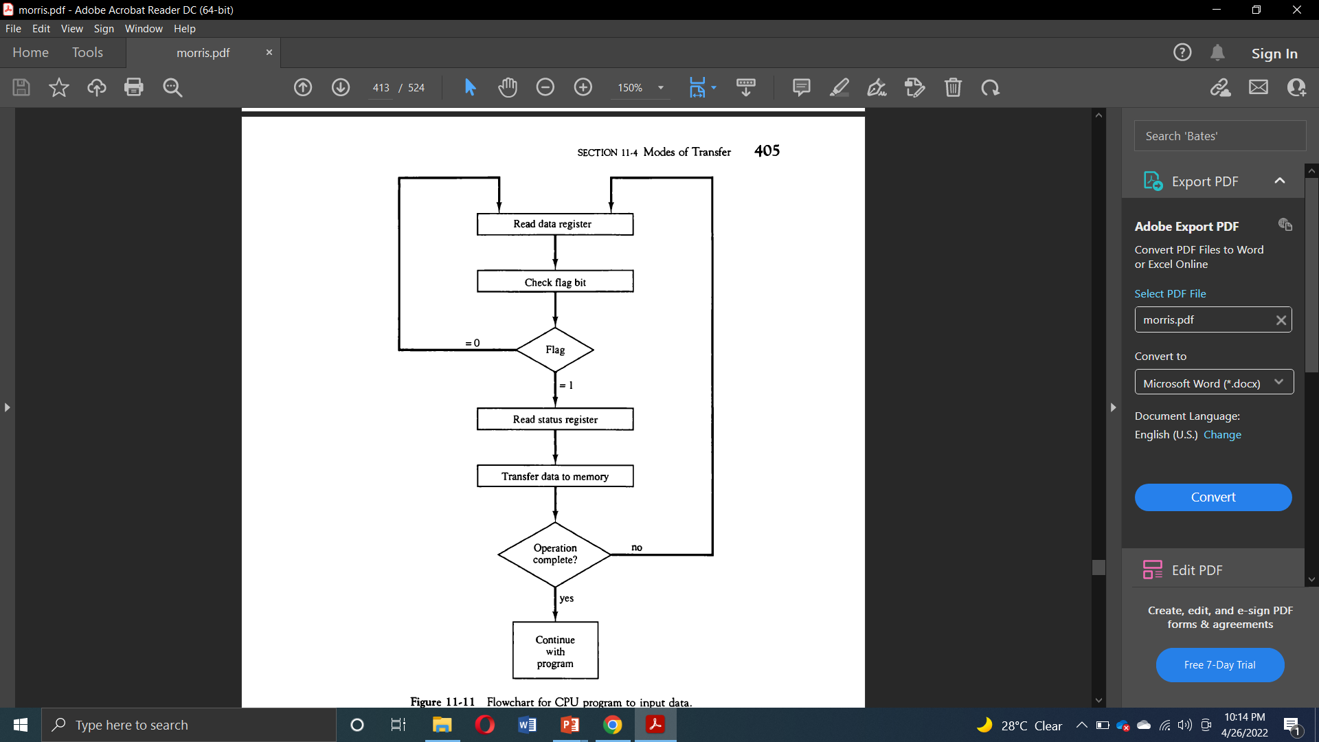
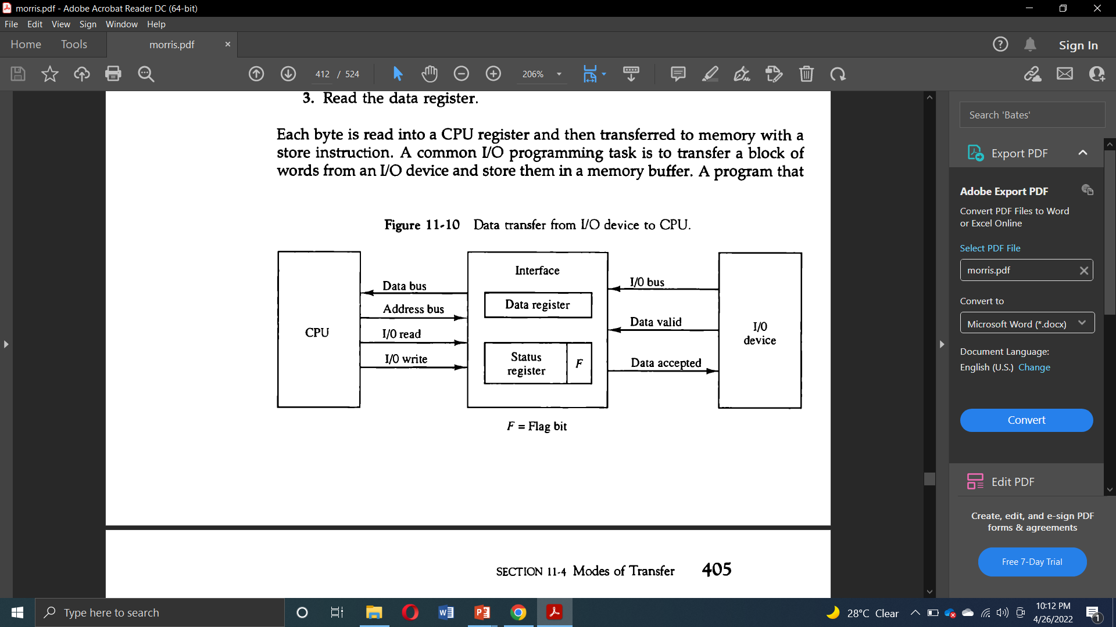
Programmed I/O Example and Flow Chart
I/O device puts the data on I/O bus and enables data valid line
The interface accepts data in data register and enables data accepted line
Interface set the flag bit, which allows I/O device to disable the data valid line
CPU program checks the flag bit and controls the data transfer
CPU (or interface) clears (F=0) the flag after data transfer
This disables the data accepted line
I/O device is now ready to send next byte

Slide 7
Interrupt-Initiated I/O
In the programmed I/O method, the CPU stays in a program loop until the I/O unit indicates that it is ready for data transfer. This is a time-consuming process since it keeps the processor busy needlessly.
An alternative to the Programmed I/O where CPU constantly monitoring the flag is to let the interface inform the computer when it is ready to transfer data.
This mode of transfer uses the interrupt facility. While the CPU is running a program, it does not check the flag. However, when the flag is set, the computer is momentarily interrupted from proceeding with the current program and is informed of the fact that the flag has been set.
The CPU deviates from what it is doing to take care of the input or output transfer. After the transfer is completed, the computer returns to the previous program to continue what it was doing before the interrupt.

Slide 8
Interrupt-Initiated I/O - Working
As flag status is SET, the interface determines that the device is ready for data transfer, it generates an interrupt request to the computer.
Upon detecting the external interrupt signal, the CPU momentarily stops the task it is processing, branches to a service program to process the I/O transfer, and then returns to the task it was originally performing.
The way that the processor chooses the branch address of the service routine varies from one unit to another. In principle, there are two methods for accomplishing this.
Non-vectored interrupts : branch address is assigned to a fixed memory location
Vectored interrupts: source of interrupt provides the branch address (called interrupt vector) to the computer. In some computers the interrupt vector is the first address of the I/O service routine whereas in other computers the interrupt vector is an address that points to a location in memory where the beginning address of the I/O service routine is stored.

Slide 9
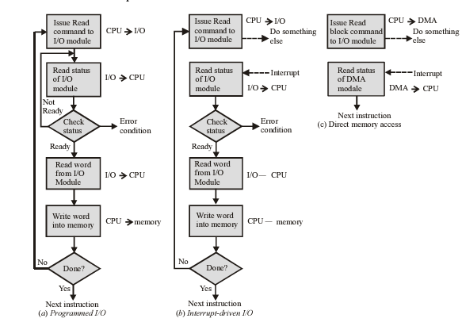
Data Transfer - Flow Charts
Flow Chart of Programmed I/O, Interrupt-driven I/O and DMA Modes of Data Transfer

Slide 10
Interrupt-Initiated – Software Consideration
Software Consideration
Previous discussion was concerned with the basic hardware needed to interface I/O devices to a computer system.
A computer must also have software routines for controlling peripherals and for transfer of data between the processor and peripherals.
These I/O routines must issue control commands to activate the peripheral and to check the device status to determine when it is ready for data transfer.
In some cases, a control command is then given to execute a device function such as stop tape or print characters.
Software must manage interrupt priorities effectively to prevent vital tasks from being delayed by less important ones.
Software must efficiently manage interrupt-driven I/O operations to maximize throughput and minimize latency.

Slide 11
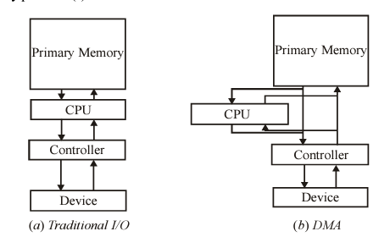
Direct Memory Access (DMA)
Transfer of data between memory and I/O devices without the intervention of CPU. It is the fastest mode of data transfer.
During DMA transfer CPU is idle, and control of the memory bus is with the DMA controller.
The processor just initiates the data transfer by sending the starting address and the number of bits to be transferred and proceeds with the pervious task.
The DMA technique is particularly useful for transferring large amount of data (e.g. images, disk transfer, etc.) to memory.
DMA requires additional hardware, such as a DMA controller, DMA memory partition(s) and a fast bus.
Comparing the Functioning of Traditional I/O and DMA

Slide 12
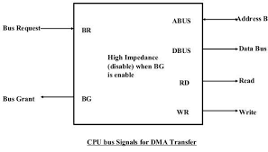
Direct Memory Access (DMA)
DMA controller sends a Bus Request (BR) signal to CPU to relinquish control of buses.
CPU terminates the execution of current instructions and put data bus, address bus and memory read/write lines in high impedance state.
CPU then issues a Bus Grant (BG) access to DMA controller
After the transfer, DMA disables the BR line and CPU disables the BG line
DMA is ideal for high speed memories

Slide 13
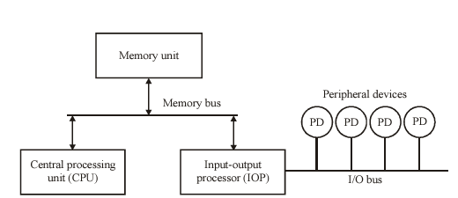
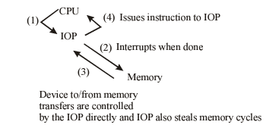
Other Direct Transfer Modes
Input–output processor (IOP) :- In IOP CPU assigns the task of initiating the I/O operation by testing the status of IOP. If the status is fine, the processor continues its other works and IOP handles the I/O operation. After the input is completed, IOP transfers its content to memory by stealing one memory cycle from CPU. Similarly, an output is directly transferred from memory to IOP, stealing a memory cycle and from IOP to the output device at a rate the device accepts the output as shown in below figure.
Block Diagram of an IOP
Data Transfer between IOP and CPU

Slide 14
Other Direct Transfer Modes
Data communication processor (DCP):- DCP is an I/O processor that distributes and collects data from numerous remote terminals connected through telephone and other communication lines to the computer.
It is a specialized I/O processor designed to communicate with data communication networks.
The data communication processor communicates with each terminal through a single pair of wire.
It also communicates with CPU and memory in the same manner as any I/O processor does.
These processors are commonly found in networking equipment such as routers, switches, and network interface cards (NICs), as well as in other devices that require high-speed data transfer and communication capabilities.
DCPs are responsible for processing packets, Traffic Management, Security, protocol handling etc.

Slide 15
Exercise Questions
Why is Programmed I/O mode of data transfer is slow?
Why CPU is in the idle state during the Direct Memory Access?
Direct Memory Access is ideal for slow memories. True or False?
Vectored interrupt is ?
CPU is actively involved in the transfer of data in interrupt-initiated I/O mode. True or False?
Stealing a memory cycle in IOP is ?
Status register Vs Flag.
Various commands an I/O interface may receive.
Strobe vs Handshake signal

